Slide 1
Zengine Ii by WizeHive
For the Reviewer
12.13.2023

Slide 2
Contents
Overview
The Reviewer Experience
Reviewing an Application

Slide 3
Overview
This resource will provide information and instructions on how reviewers complete their review assignments and submit feedback on an application/summary form.

Slide 4
Create a login
Step by step

Slide 5
https://zengine2.zendesk.com/hc/en-us/articles/19503804654107-Log-On-as-an-Administrator-Video

Slide 6
Step 1: Cami will send you 5 invitations inviting you to become a Program Reviewer for each grant program (JAG, VOCA, JJDP (SF), JJDP (TP) and VAWA). Wait for all five invitations to come through before creating your login ID and password.
Step 2: Once all five invitations are received, please open one invitation, and hit the blue Log In button in the middle of the screen. This will take you to a page titled Create an account for The Alamo Area Council of Governments - Criminal Justice
Step 3: Select the tab on the left at the top titled "I am a new user"
Step 4: Enter your first and last name.
Step 5: Enter your regular email address as cgoldspink@aacog.com (contact Cami if you submitted a summary form with this email address already as you will need a modifier or a completely different email address).
Step 6: Enter a valid phone number. This will be an identifier in the event you forget your password the system will be able to recognize it is you by your phone number. Make sure you enter it correctly.
Step 7: Enter a password you are comfortable with and will remember. Select the blue eye looking image on the right of the password field so you can see the passwords you entered match.
**Your password should be 6 or more characters, including at least one upper case character and one lower case character and one digit.**
Step 8: The system will take you to a screen requiring a 6-digit code – that code will be emailed to you.
Step 9: after you have obtained the 6-digit code – enter it and select next or submit.
Step 10: The system should take you into the portal – go to the programs tab on the left menu bar. When you see the five funding streams select the blue open button on one of them. You should then see a review assignments tab on the left menu bar. Select review assignments – it should show you have zero assignments because I have not assigned any applications yet.
Then you are done, and you can log out.
NOTE: Save it to your favorites bar so you don’t have to go to the emails to login each time.

Slide 7
Review/Score
The Reviewer Experience

Slide 8
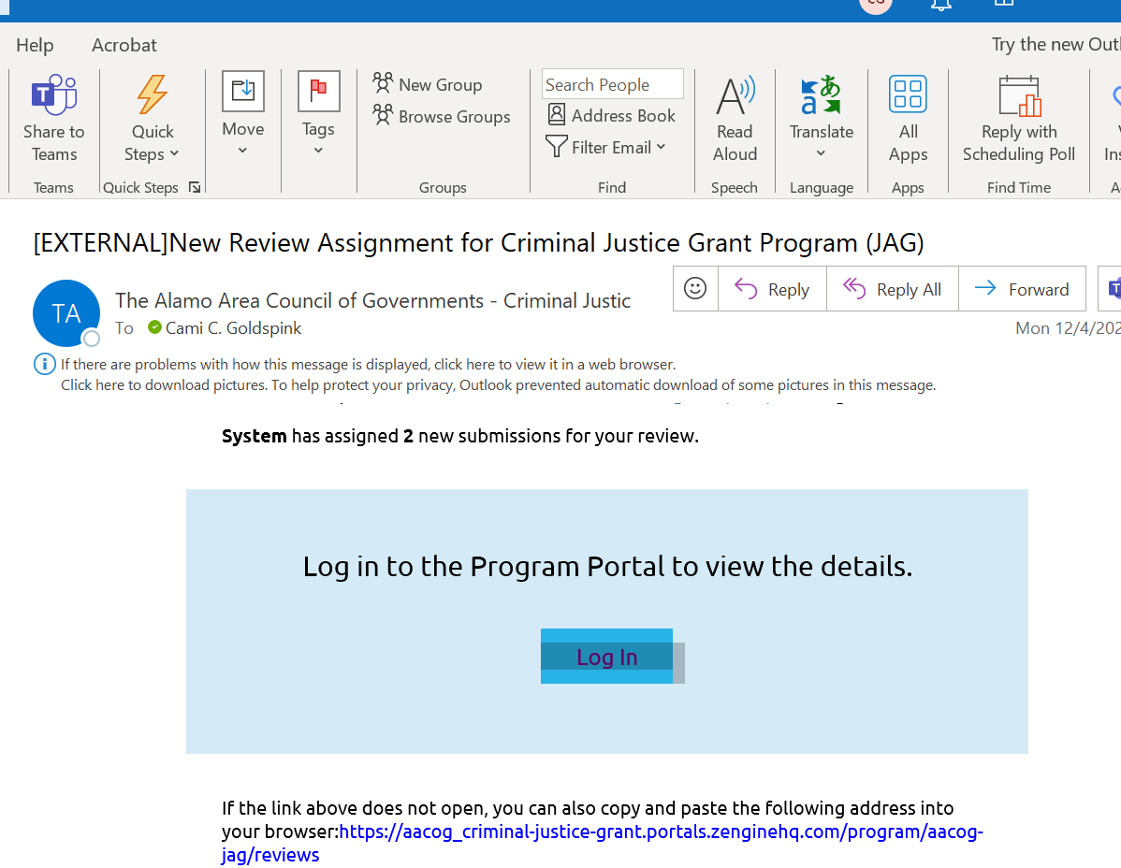
Reviewers will receive an email notification when they have new assignments to review and provide feedback. It will look like the screenshot below:

Slide 9
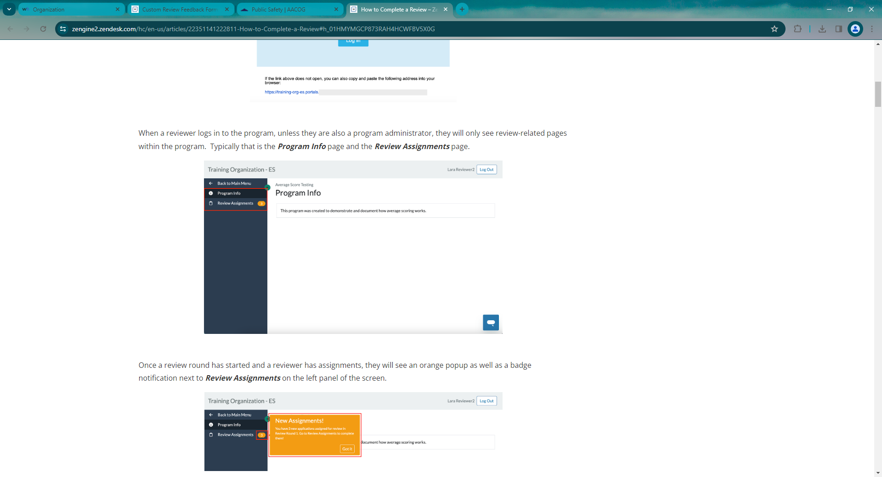
When a reviewer logs into the program, unless they are also a program administrator,
they will only see review related pages within that program. Typically, that is the
Program Info page and the Review assignments page.

Slide 10
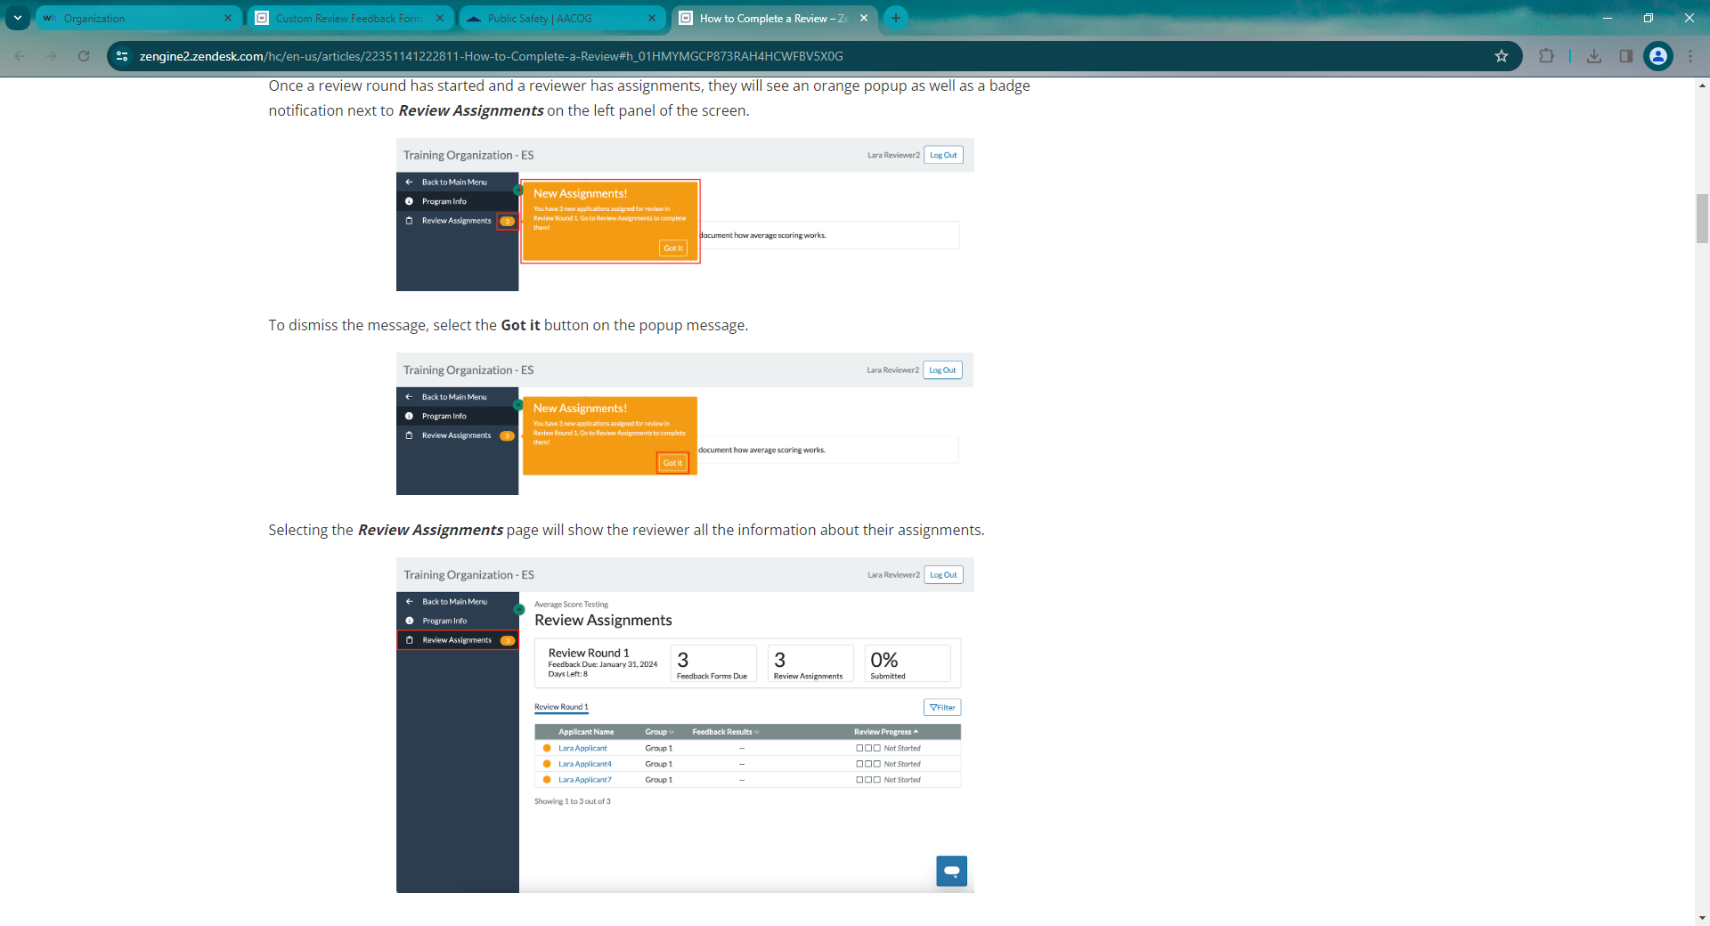

Slide 11
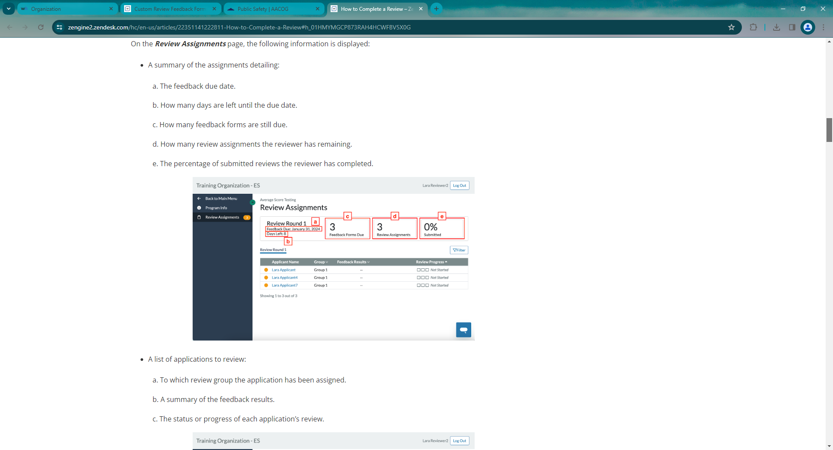

Slide 14
Reviewing an application
The Reviewer Experience
https://zengine2.zendesk.com/hc/en-us/articles/22351141222811-How-to-Complete-a-Review#h_01HMYMGCP873RAH4HCWFBV5X0G

Slide 15
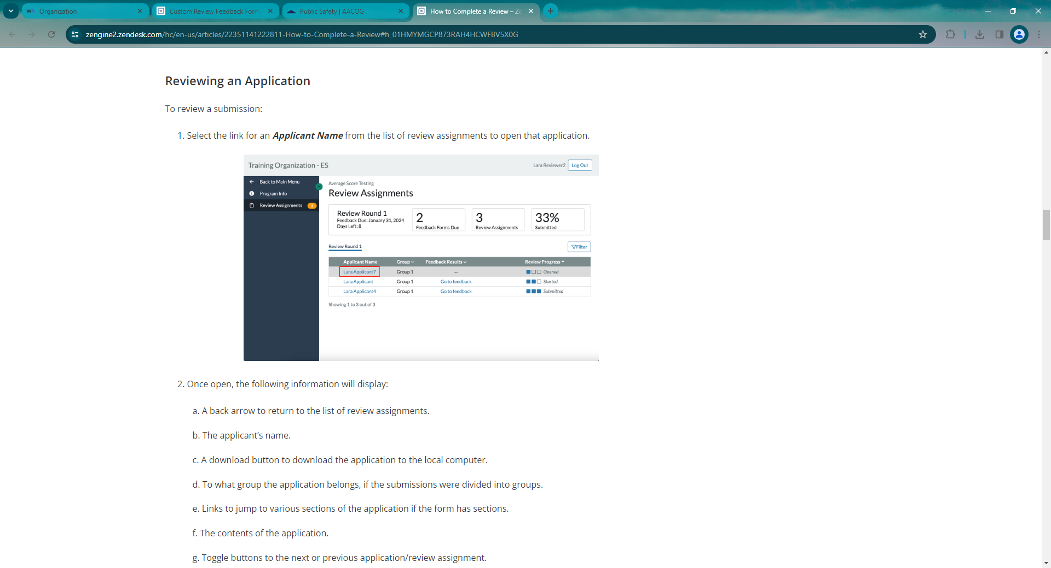

Slide 16
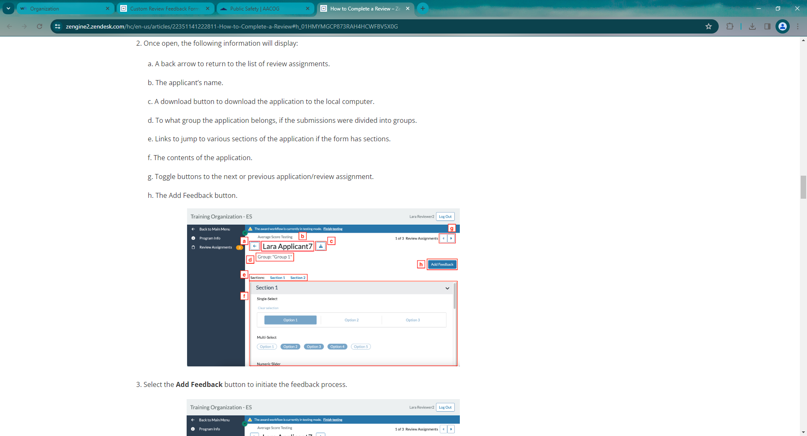

Slide 17
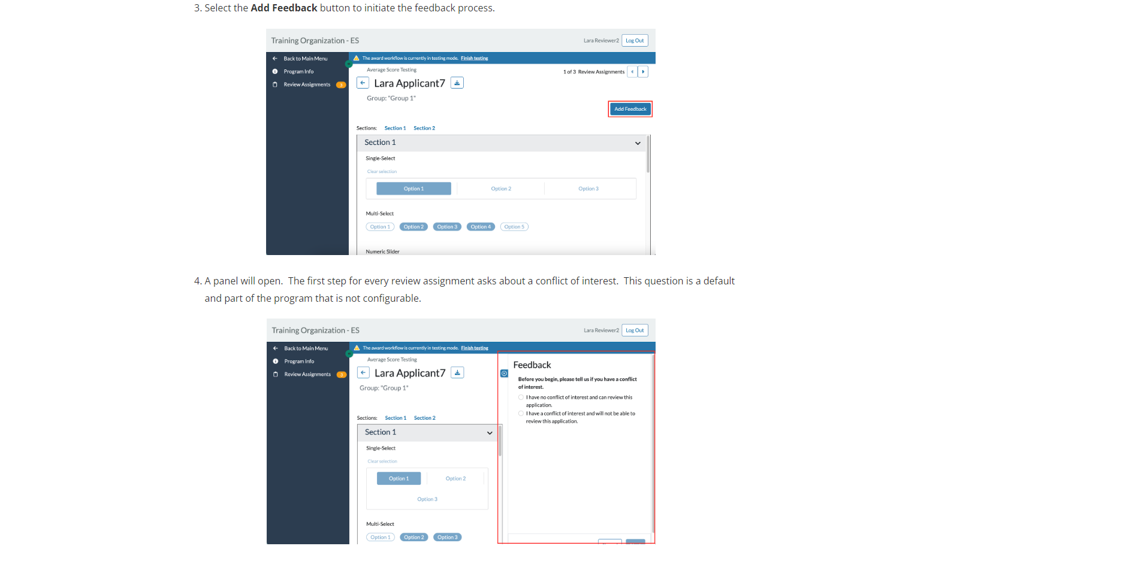
You can move through each assignment by toggling through using the forward and backward buttons here.

Slide 18
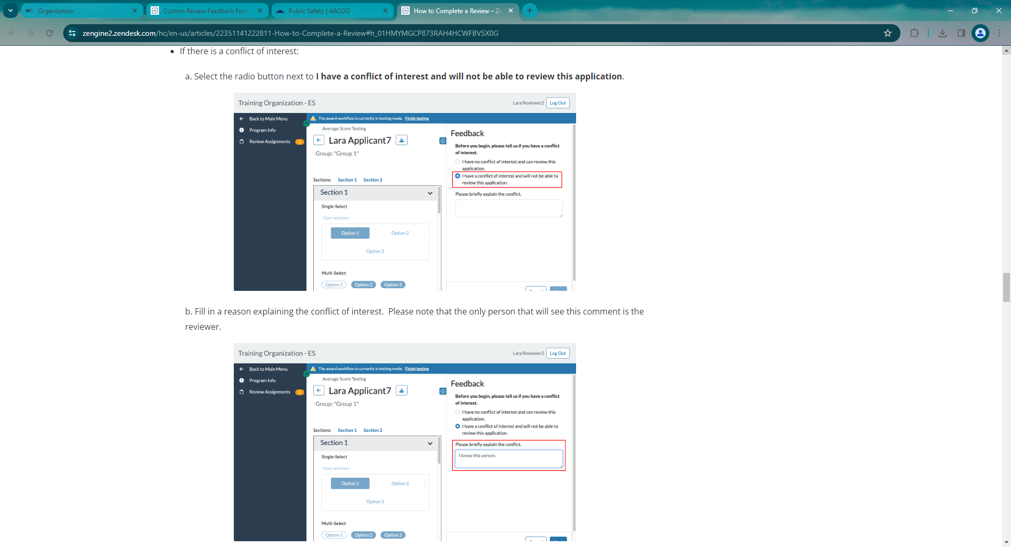
IF THERE IS A CONFLICT OF INTEREST:

Slide 19
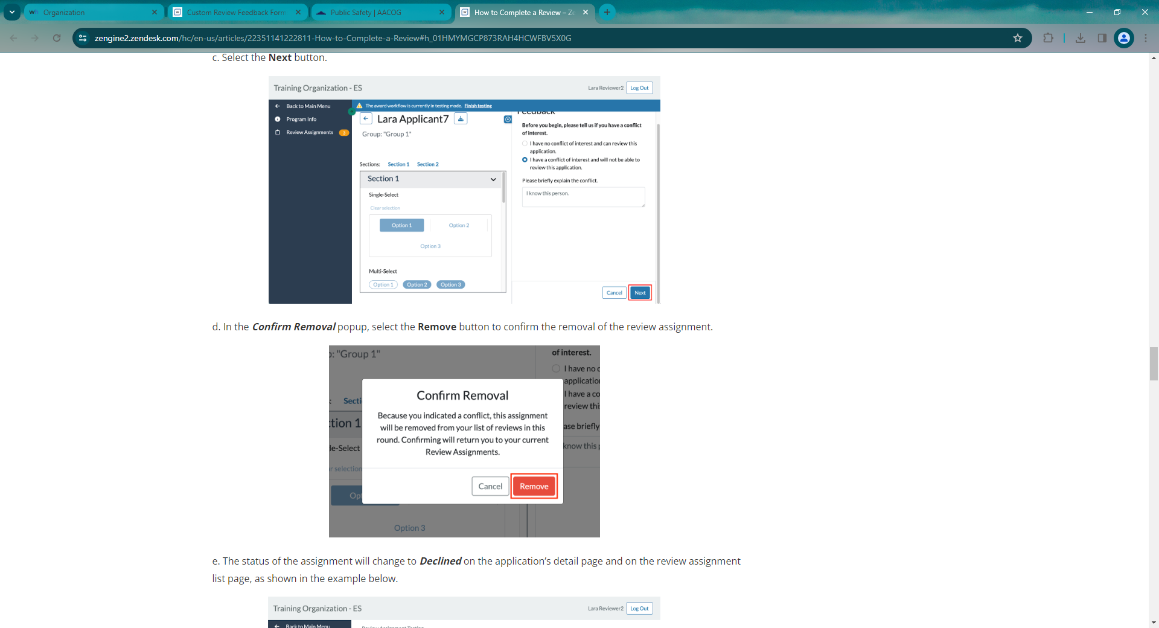

Slide 21
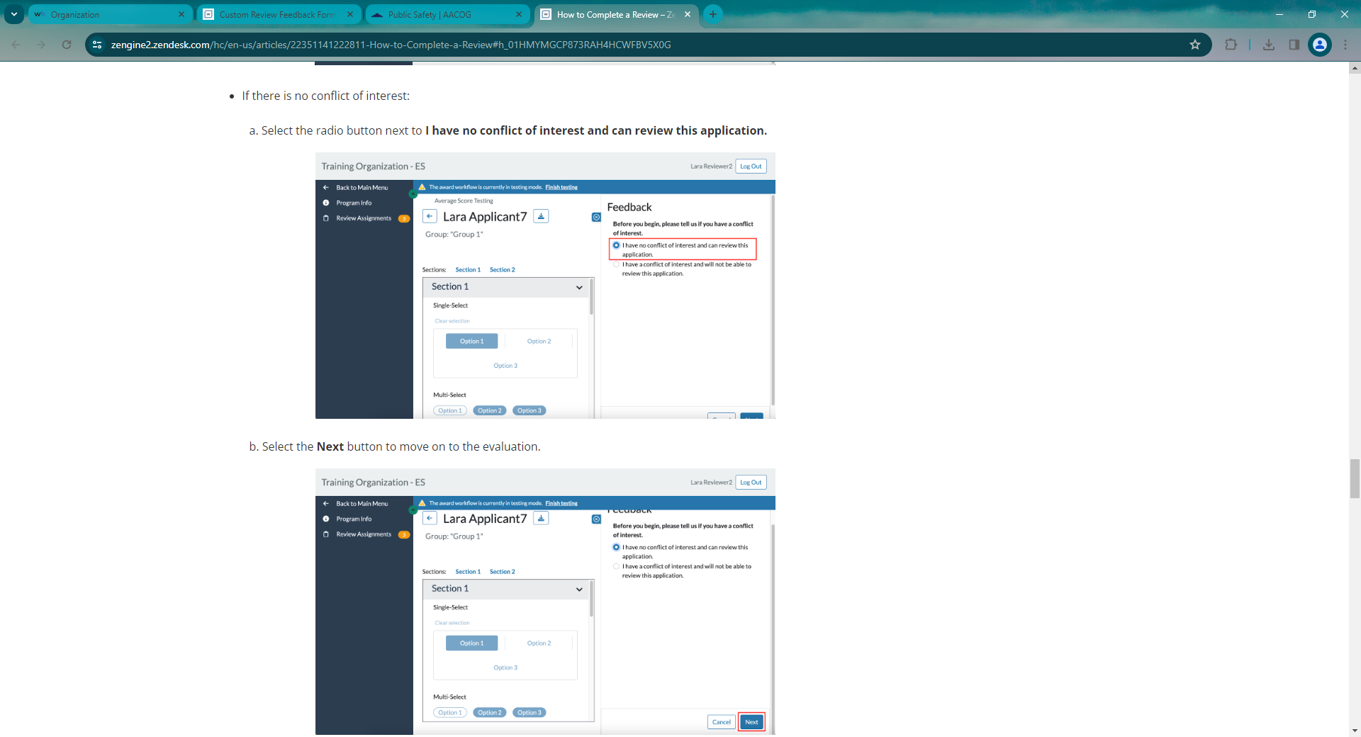
If there is NO Conflict of Interest:

Slide 23
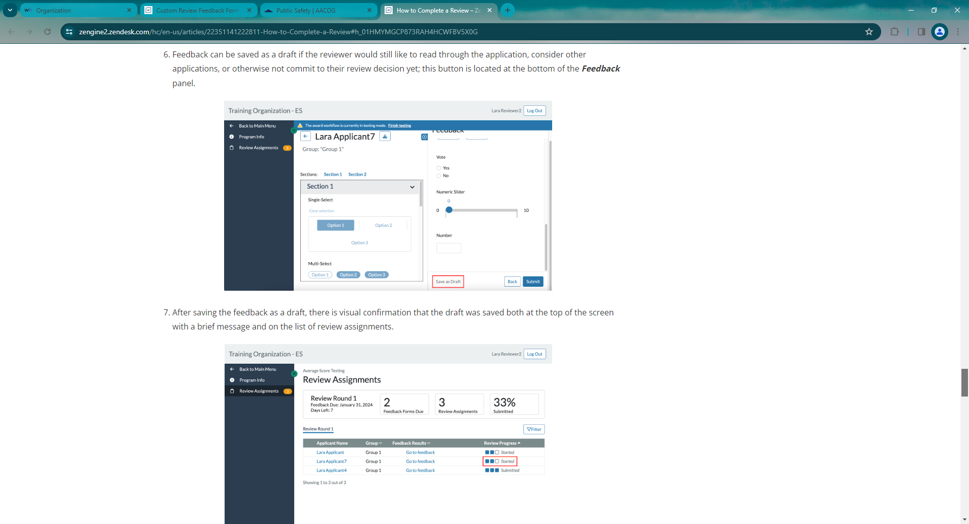

Slide 25
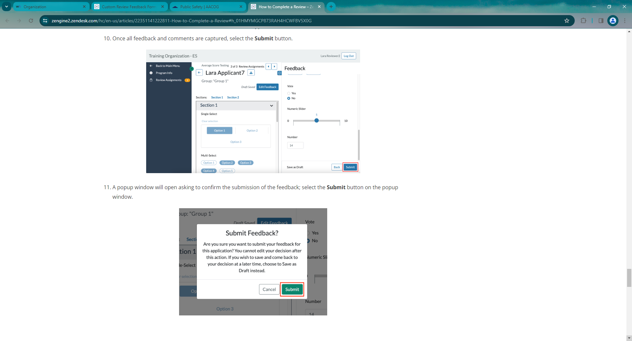

Slide 26
***IMPORTANT***
SUBMITTING FEEDBACK MAKES THE FEEDBACK/SCORE TOOL INPUT FOR THAT APPLICATION NO LONGER EDITABLE.

Slide 27
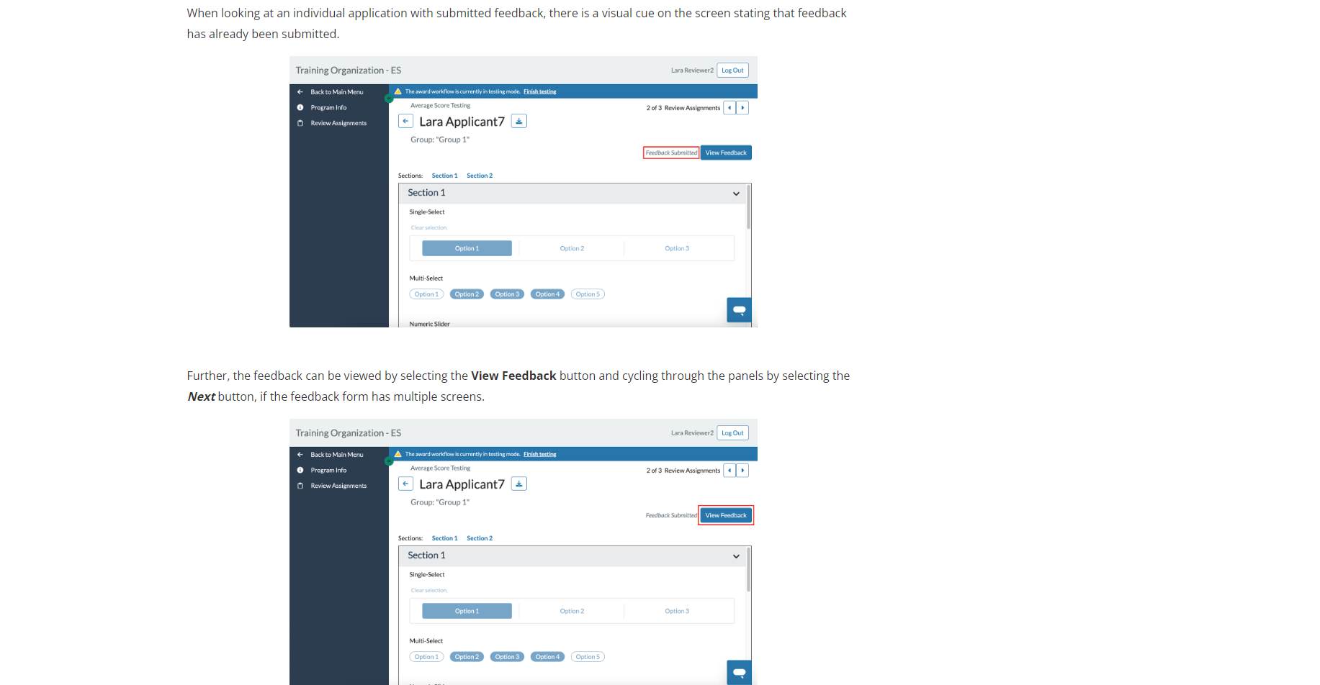

Slide 28
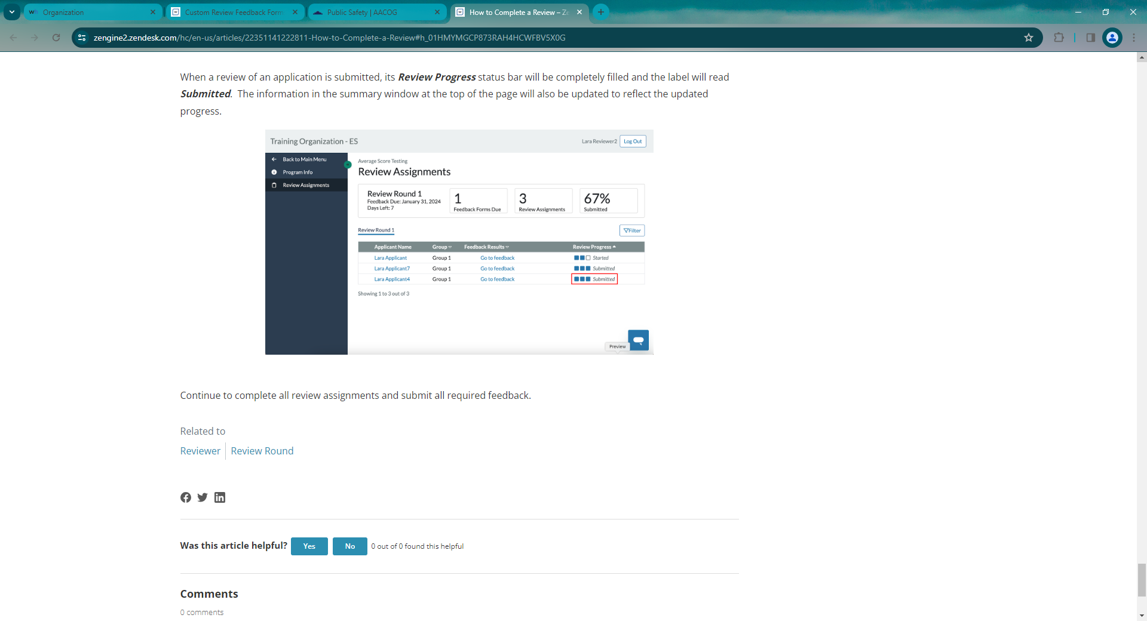

Slide 29
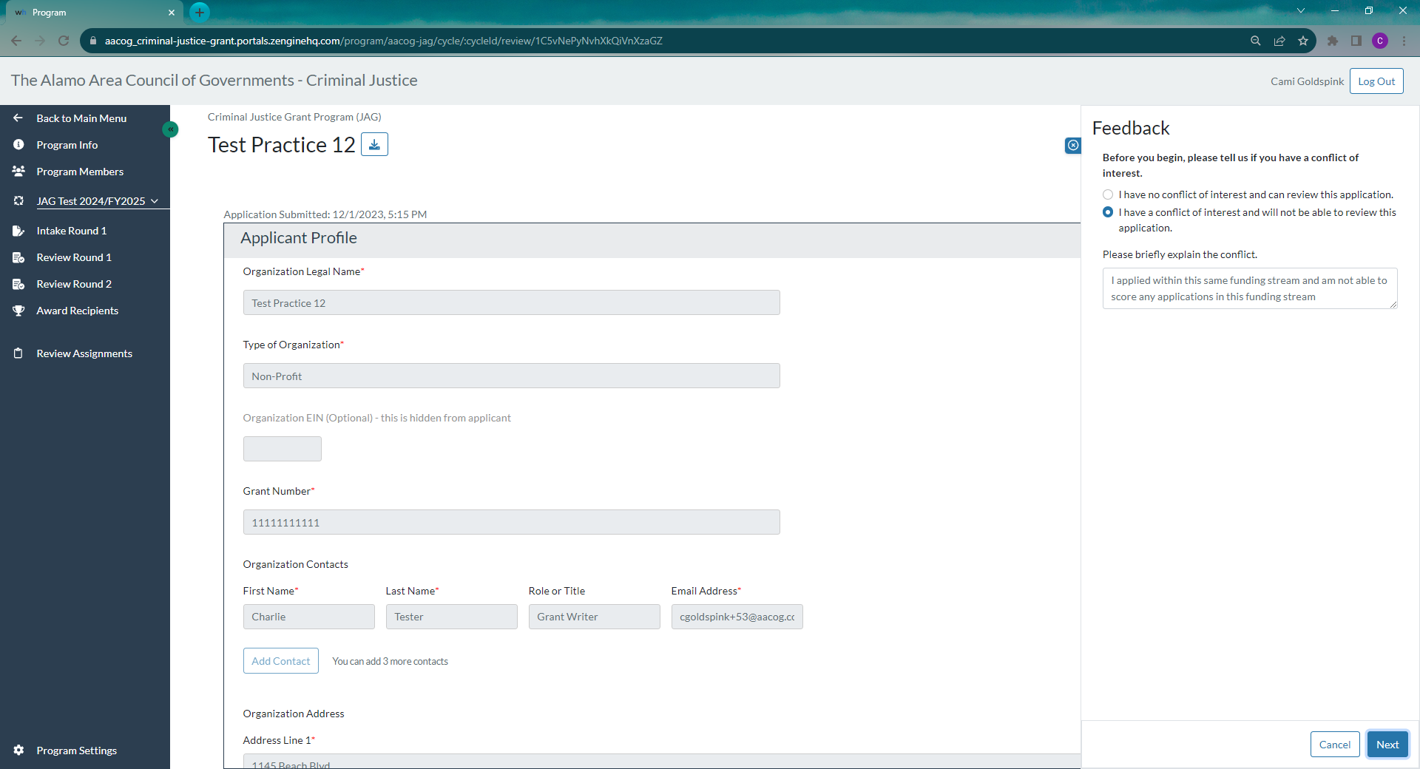
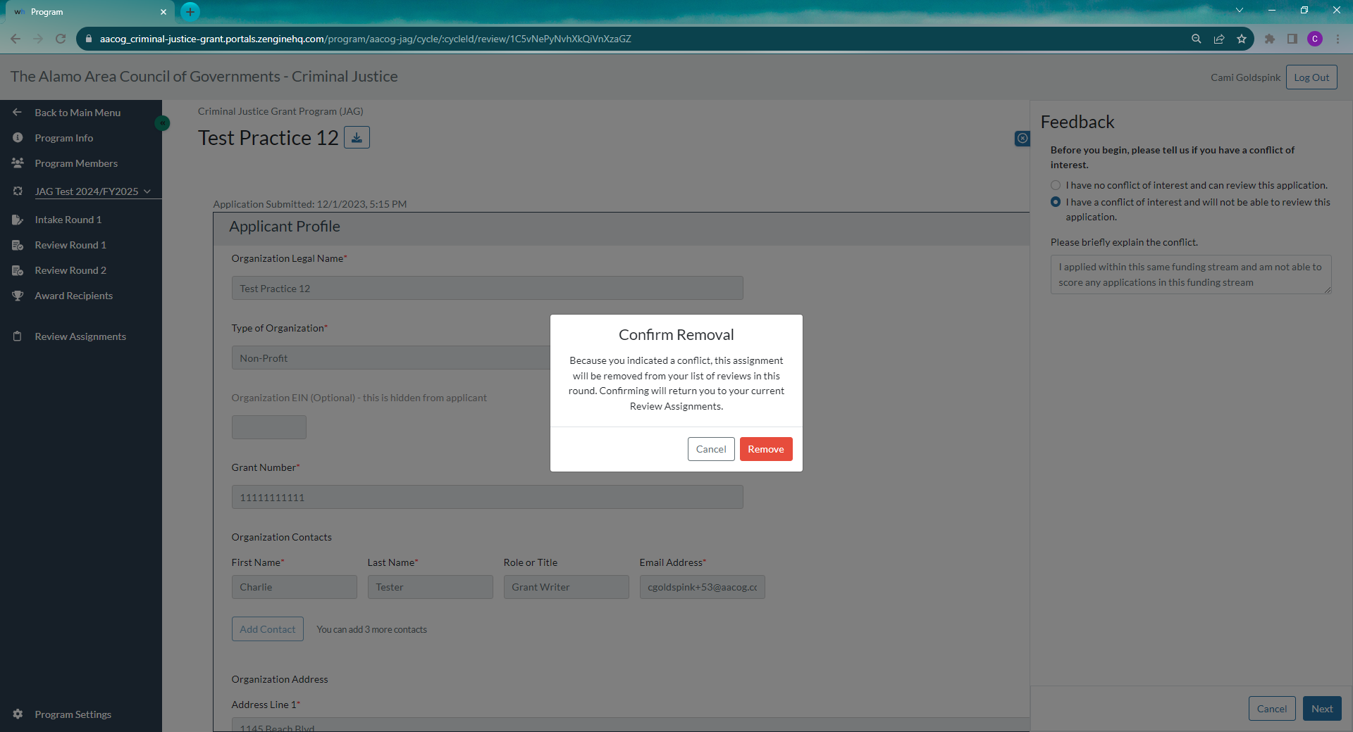
Since the testing phase of Z2 new functionality has been released. The system will now allow you to select you have a conflict and will not be able to score this application, you will state why, and then hit next. You can still review
Please submit any COIs to Cami before you leave training today.

Slide 30
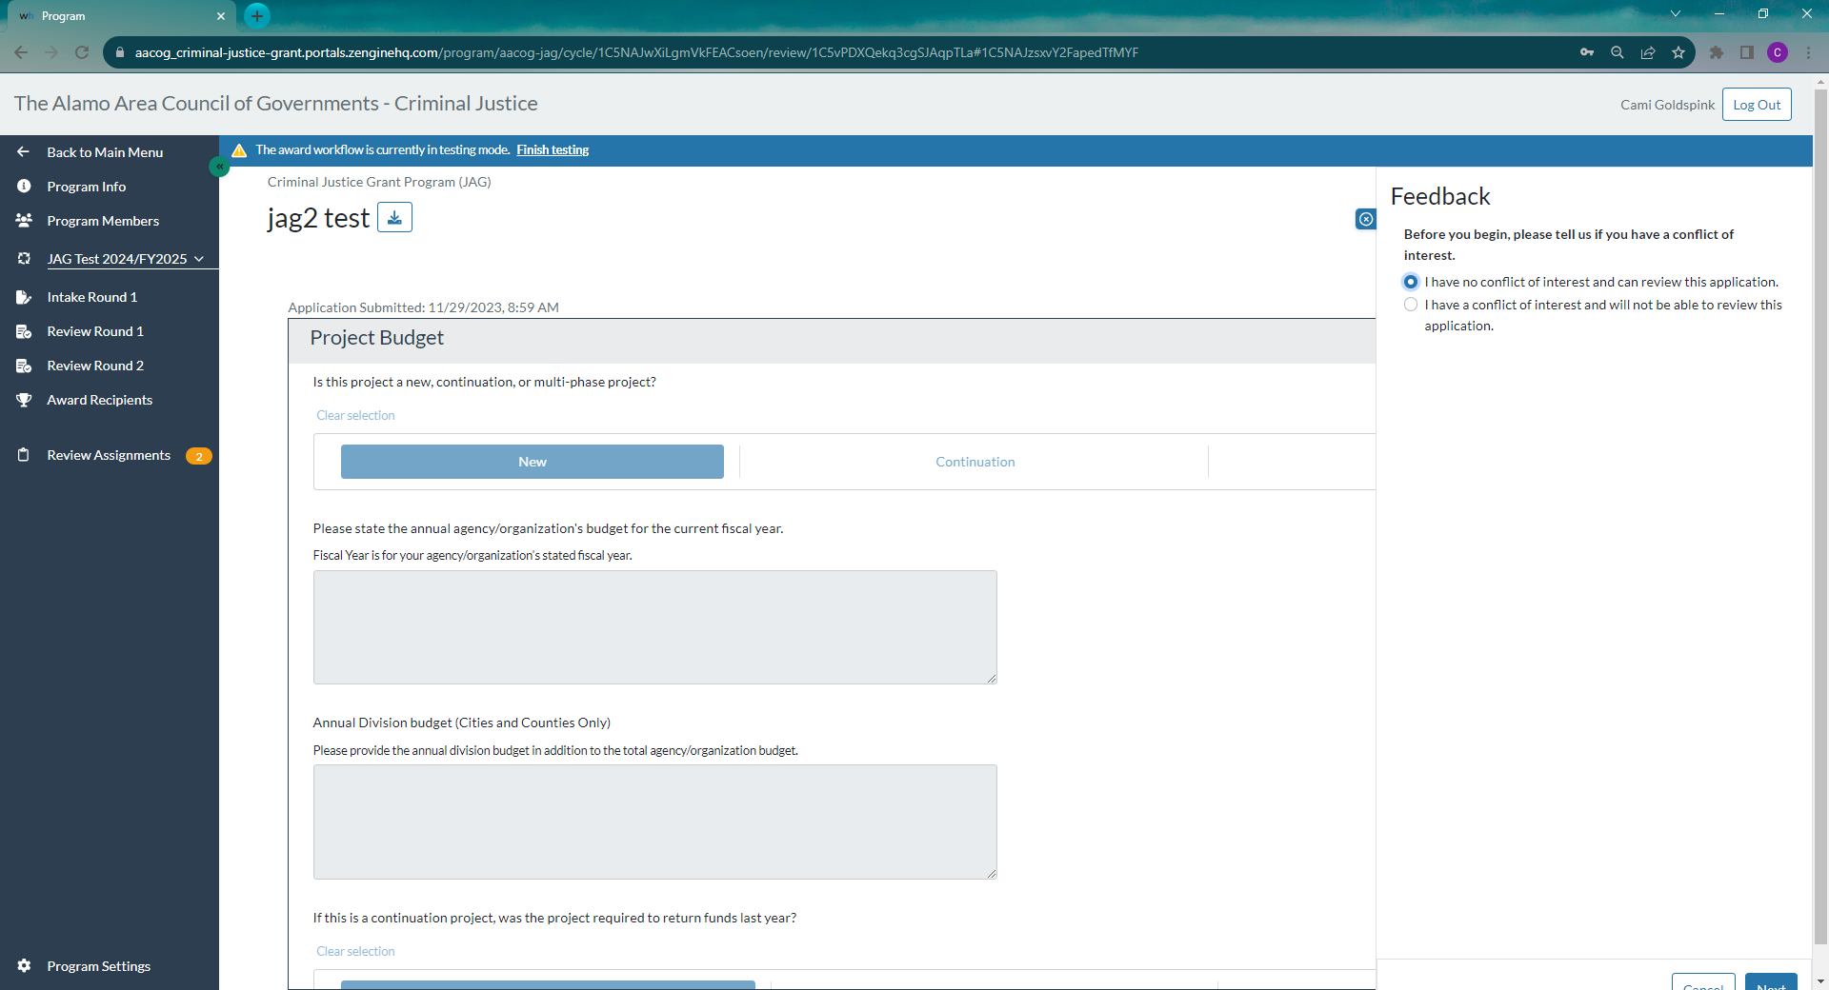

Slide 31
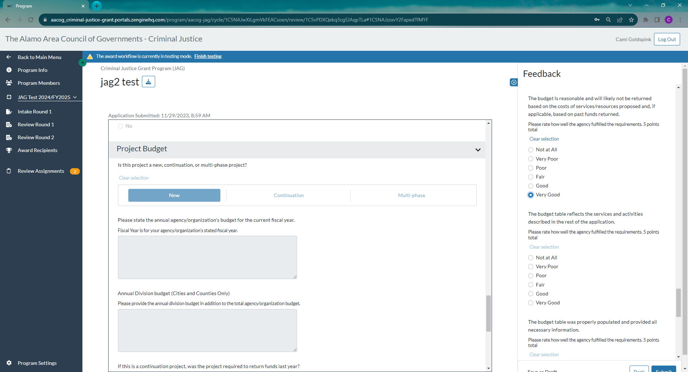

Slide 32
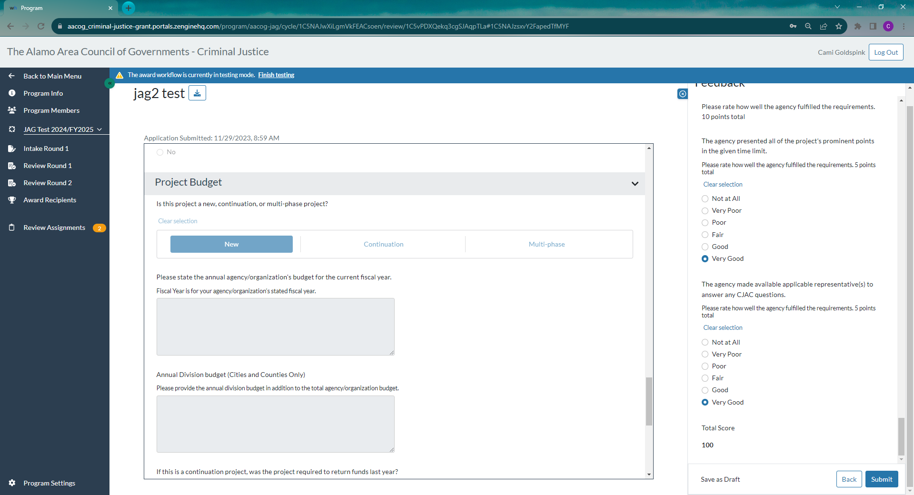

Slide 33
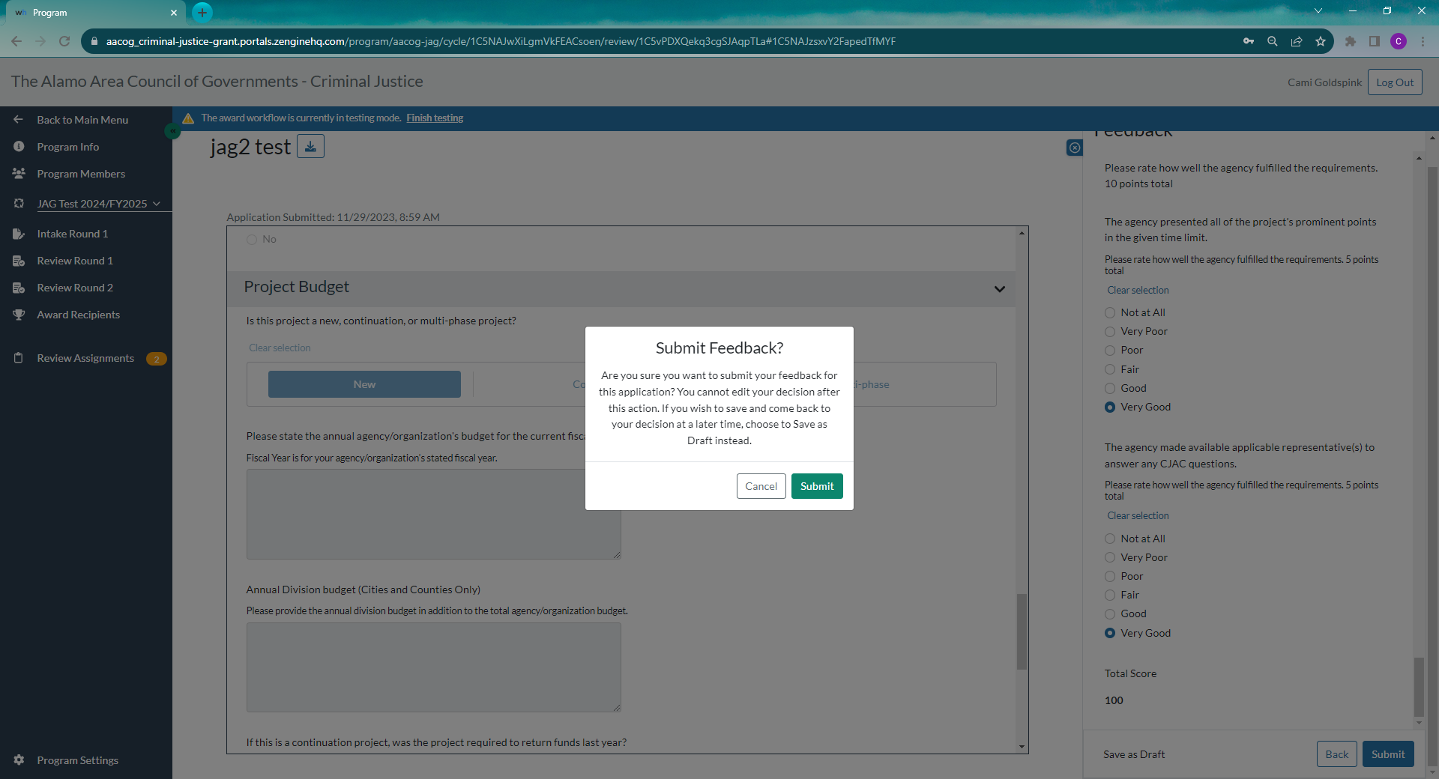
The option is now there to save this as a draft while reviewing prior to the score dates. DO NOT SUBMIT. Functionality is coming to give the option to resubmit in the event you submit a score but weren’t supposed to yet. I will turn that on once I start assigning applications to review.

Slide 34
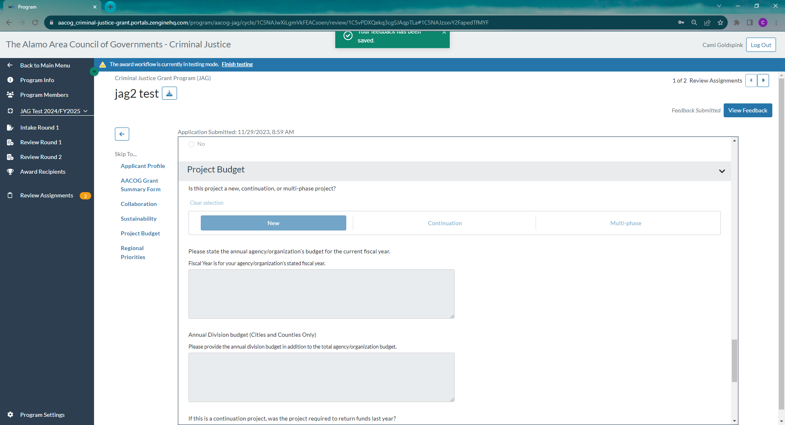

Slide 35
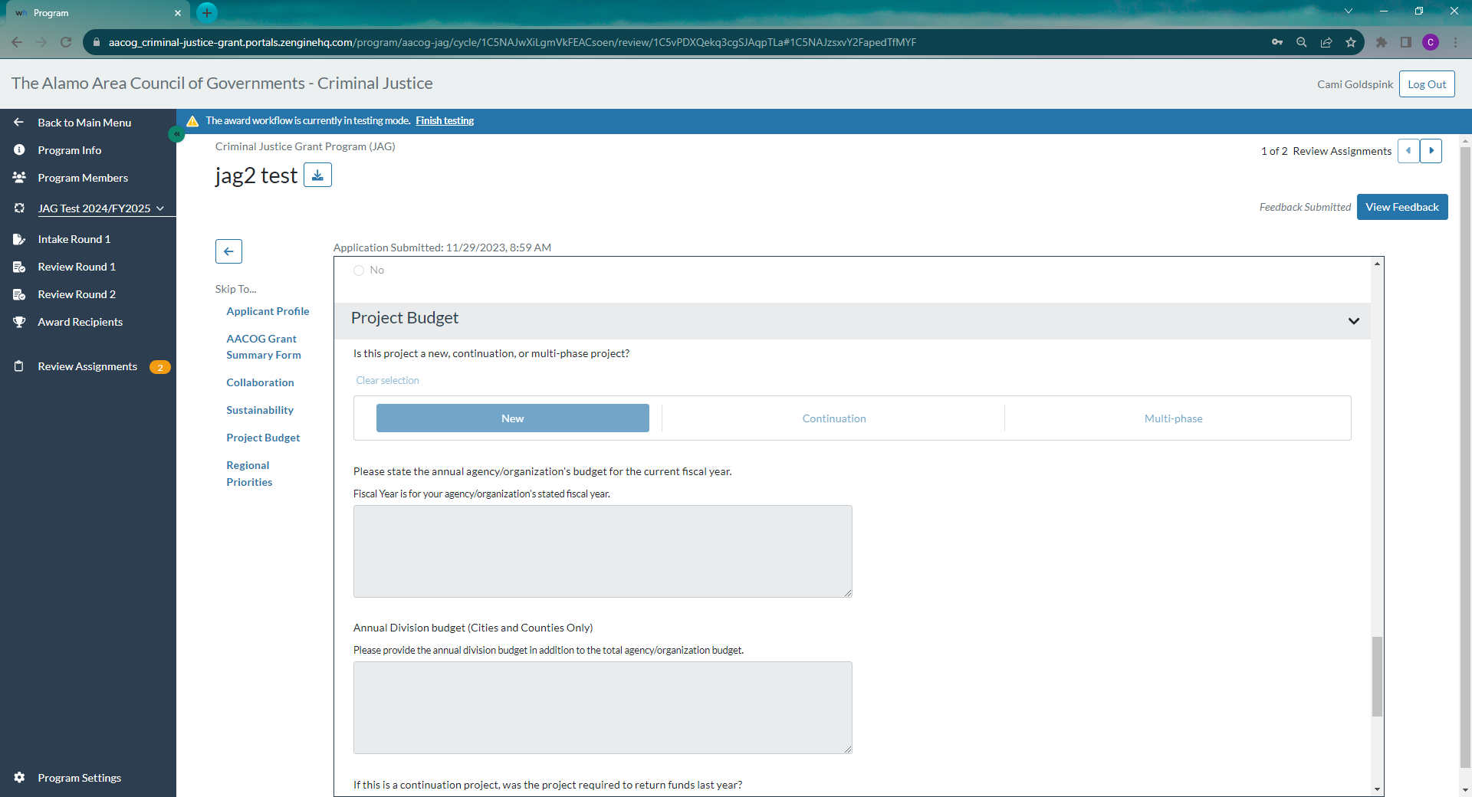
Move through each application to review by using the forward and backward arrows.

Slide 36
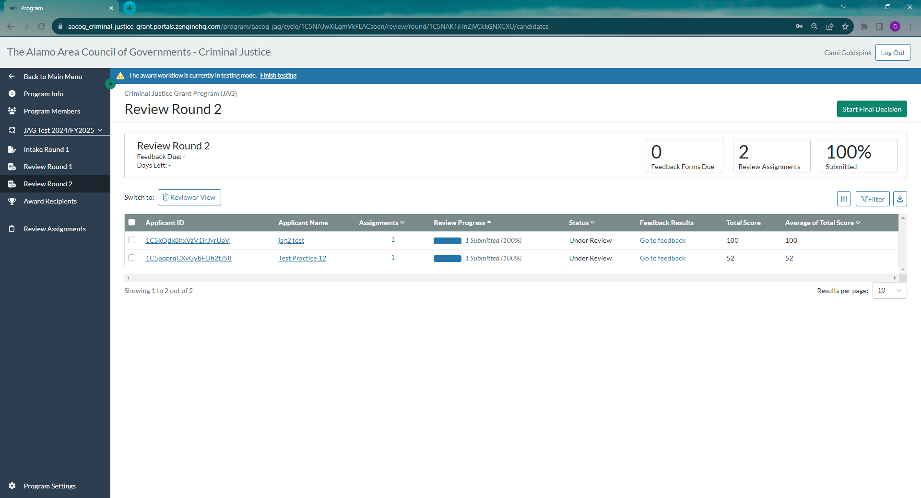

Slide 37
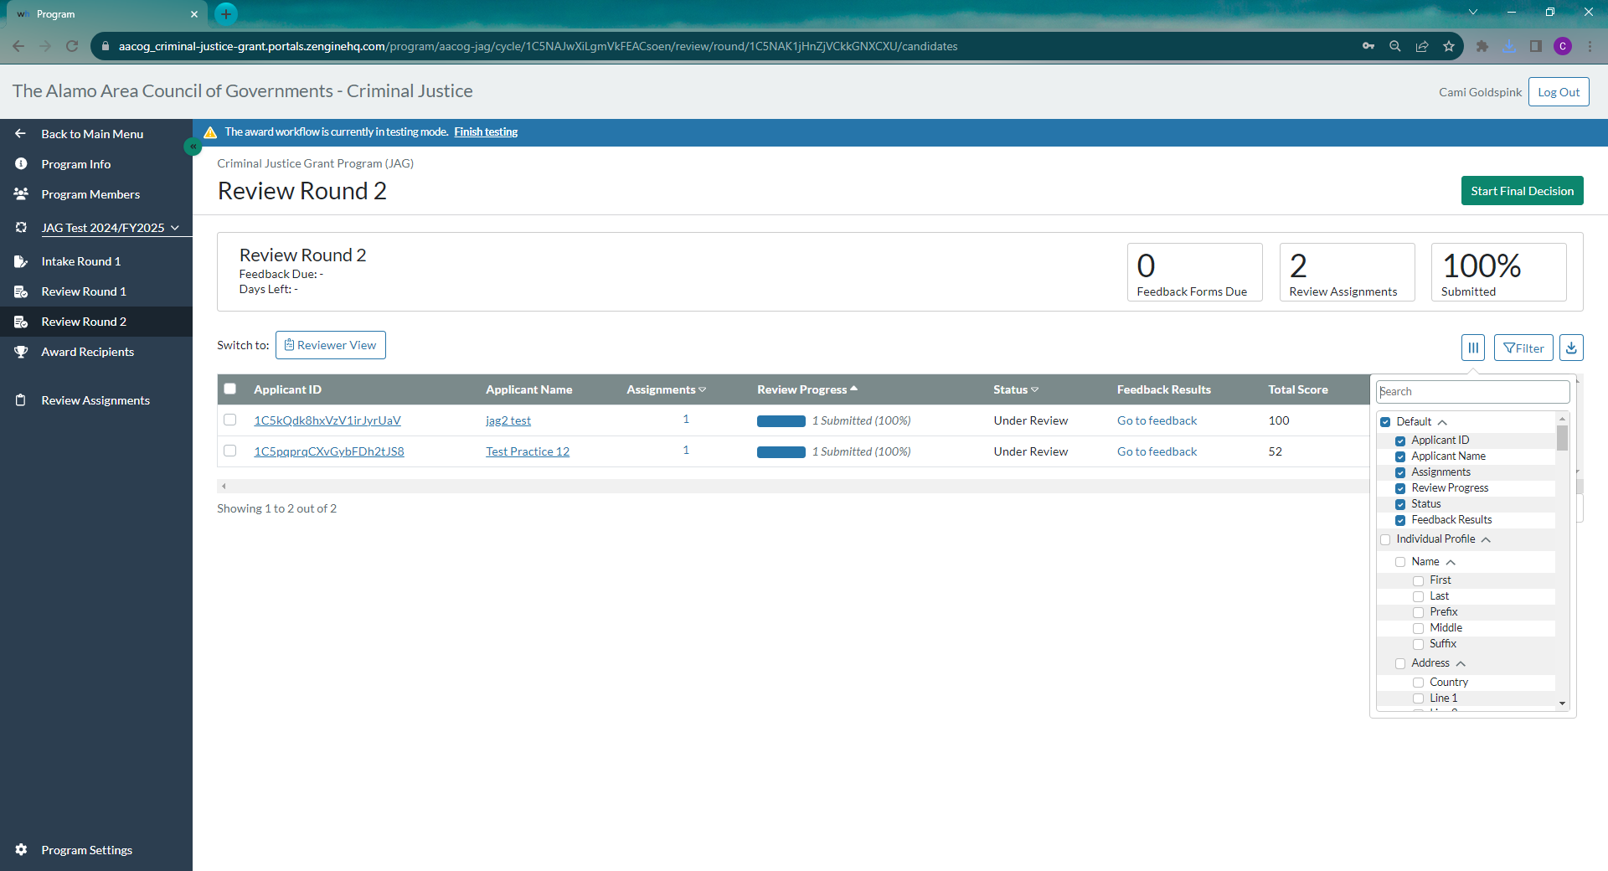

Slide 38
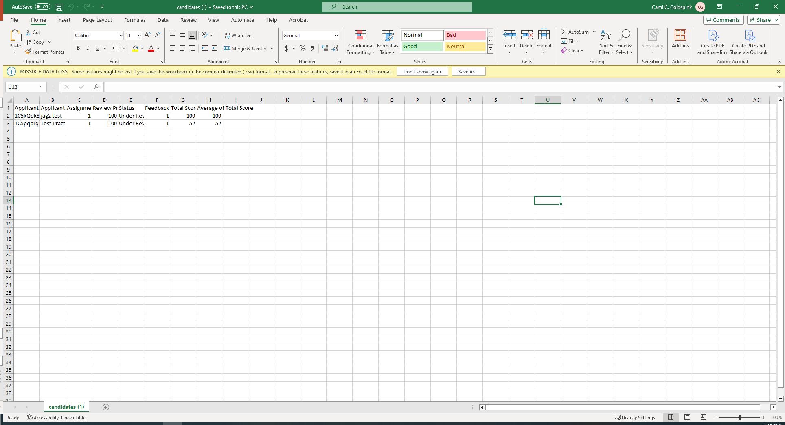

Slide 39
What to expect
LOOKING AHEAD

Slide 40
2/8/2024 – applicants completed submitting summary forms 2/13/2024 – first score training 2/13/2024 -3/15/2024 – Cog staff admin round 3/15/2024 - begin uploading grant application summaries from EGRANTS 4/15/2024 - 4/16/2024 – grant scoring dATES

Slide 41
THANK YOU
Cami Goldspink
+1 (210) 710-2619
cgoldspink@aacog.com
www.aacog.com/public-safety
How to Complete a Review Instruction Link:
https://zengine2.zendesk.com/hc/en-us/articles/22351141222811-How-to-Complete-a-Review#h_01HMYMGCP873RAH4HCWFBV5X0G

